Slide 1
Learning Objective
To learn about UT’s Coordinated Admission Program (CAP)
Agenda:
1. Announcements
2. Coordinated Admission Program

Slide 2
This Week’s Announcements
Weds. Feb. 10th Early Release
Monday, Feb. 15- BISD Holiday, but not for ACC
This Week’s Senior College Acceptances:
Congrats to Andrea for being accepted to SHSU and Texas Tech, Kai is attending UT Austin, Dolores for planning to attend ACC to be a Teacher’s Assistant and Jedd to attend Texas A&M for Pre-med

Slide 3

What is CAP?
The Coordinated Admission Program (CAP) is an opportunity for students who did not get accepted into The University of Texas at Austin to spend their freshman year at another UT campus and then transfer into UT Austin after a year.
Every year, we have several students who get accepted into UT Austin, but we also have several students who are CAP’d. Below is some information on this program since many of you will apply to UT Austin.

Slide 4
What is CAP?
https://admissions.utexas.edu/enroll/cap
“The University of Texas System developed the Coordinated Admission Program (CAP) to expand the admission options available to students interested in enrolling at The University of Texas at Austin, the system’s flagship university.
In general, CAP makes it possible for some freshman applicants to UT Austin to begin their studies at another UT System university. After completing CAP requirements during their freshman year, students transfer to UT Austin to complete their undergraduate studies.

Slide 5

What is CAP?
If you are offered and decide to participate in CAP, you don’t have to apply for admission to the UT System university you attend during your freshman year. Simply complete the CAP agreement to let us know that you want to participate. You’re guaranteed admission to most majors in UT Austin’s College of Liberal Arts upon successful completion of the program. And just like any other prospective transfer student, you’ll be able to compete for admission to majors other than those guaranteed in Liberal Arts.
As a CAP student, you’ll select from courses that have been approved for transfer to UT Austin. That means that if you complete the program successfully, you’ll return to UT Austin with at least 30 hours of transferable coursework.”

Slide 6
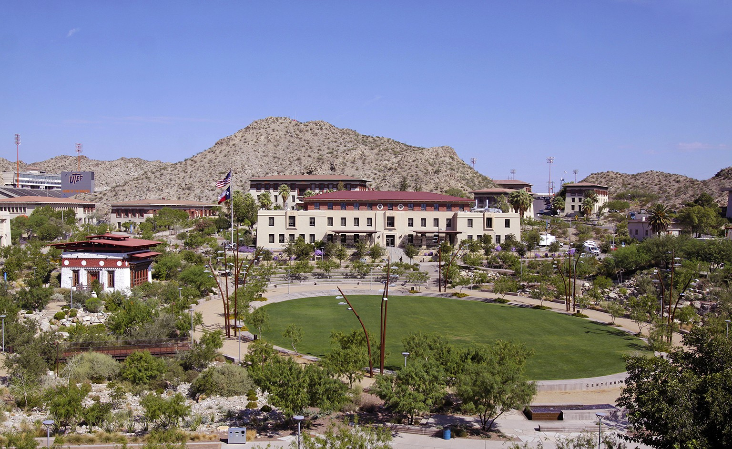
Participating UT Campuses
UT Permian Basin in Midland (6 hrs from Bastrop)
UT El Paso (9 hrs from Bastrop)
UT Arlington (3.25 hrs from Bastrop)
UT Rio Grand Valley (5 hrs from Bastrop)
UT Tyler (4 hrs from Bastrop)
UT San Antonio (2 hours from Bastrop)
“Students are offered the opportunity to participate in CAP only at the universities for which they meet enrollment requirements.”
The pic above is UT El Paso

Slide 7
Cap
Requirements
Complete 30 hours of transferable coursework at another UT school
Fulfill the Math Requirement
Earn a 3.2+ GPA on the coursework you complete
Submit your final transcript

Slide 8
CAP
FAQ
https://admissions.utexas.edu/enroll/cap/prospective-students/faqs
Do I have to submit an application to the CAP school I select?
No, you do not. If you complete and submit the online CAP agreement, we will send your application materials to the UT System school you select.
Why wasn’t I offered admission to some of the UT System schools?
All participating UT System schools have established minimum enrollment requirements for CAP students. Students are offered the opportunity to participate in CAP only at the universities for which they meet enrollment requirements.

Slide 9
CAP
FAQ
https://admissions.utexas.edu/enroll/cap/prospective-students/faqs
Can any student attending a UT System school participate in CAP?
No, to participate in CAP a student must have applied to UT Austin, been offered participation in CAP, and returned the online CAP agreement by the deadline.
May I transfer from one UT System school to another while I'm in CAP?
No, once you enroll at the UT System school you wish to attend during your freshman year, you must complete all your CAP requirements at that institution.

Slide 10
CAP
FAQ
https://admissions.utexas.edu/enroll/cap/prospective-students/faqs
What happens if I don't complete the requirements by June 1?
If you do not complete the requirements by June 1, you will no longer have guaranteed admission to UT Austin.

Slide 11

What should I do?
If your dream is to attend UT Austin, then this may be an option.
It is very important to understand that just because you have been accepted into the university DOES NOT mean you have been accepted into the major that you want.
This is a good opportunity for students with no college credits, who would spend their Freshman year at another UT university and then three years at UT Austin.
However, you already have 60 credits from ACC, CAP requires another 30 hours, so that means changing schools in your Junior or Senior year.

